Slide 1
6.0 INTRODUCTION TO REDOX REACTIONS
Redox reaction: A reaction occurring between an oxidizing agent and a reducing agent.
Oxidation: Is the loss of electrons and any substance which gains or receives electrons is an oxidizing agent.
Reduction: Is the gain of electron and any substance which losses or donates electrons is the reducing agent.

Slide 2
Eg.
Ce⁴⁺ is the oxidizing agent and Fe²⁺ is the reducing
agent.
Types of Electrochemical cells
Voltaic cell: Chemical reactions producing
electrical energy. Eg. Flashlight battery, etc
2. Electrolytic cell: Electrical energy forces non
spontaneous reaction to occur. Eg. Electrolysis of
water.

Slide 3
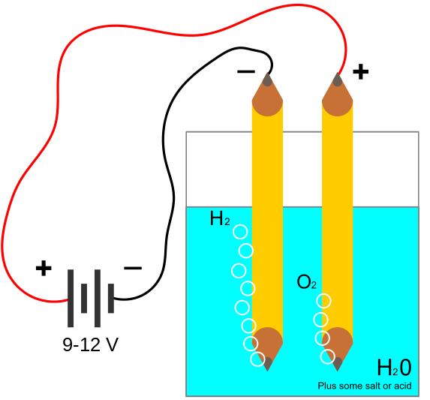
Electrolysis of Water

Slide 4
Anode: Electrode where oxidation occurs.
Cathode: Electrode where reduction occurs.
Half cell reactions and potentials
Consider this reaction,
There is electron transfer between them. We can
make use of these electrons by separating the
reactions into compartments called half reaction
compartment.

Slide 6
Normal or Standard Hydrogen Electrode
Assigned = 0.00 V

Slide 8

Representation of a galvanic cell
anode/solution//soluiton/cathode
Nernst Equation
For the reaction,
The reduction potential,
R = gas constant (8.3143 V coul deg⁻¹ mol⁻¹)

Slide 9

n = # of electrons involved in half cell (eq mol⁻¹)
T = absolute temperature (K)
F = Faraday’s constant (96,487 coul eq⁻¹)
At 25ºC, the value of 2.3026RT/F is 0.05916.
Therefore,
Note: The concentration of pure substance is taken
as unity.

Slide 10
Voltage of a cell
Calculated using the Nernst equation for each half
cell to give a positive potential as.
Potential dependence on pH
H⁺ is involved in many redox reaction. The potential
of such reactions can be altered by changing the
pH of the solution.
Consider the As(V)/As(III) couple:

Slide 11



Redox reaction:
The Nernst equ:

Slide 12

Potential dependence on complexation
If an ion in solution is complexed, its
concentration decreases hence the potential.
When 1M HCl is added to Fe²⁺/Fe³⁺ couple, the
Fe³⁺is complexed by Cl⁻ and the E⁰ decreases from
0.771 to 0.70 V
If we assume that the complexed formed is FeCl₄⁻
FeCl₄⁻ + e⁻ ⇋ Fe²⁺ + 4Cl⁻

Slide 13
7.0 REDOX AND POTENTIOMETRIC TITRATION
Balancing redox reactions
Balance the reaction:
Equilibrium constant at the equivalence point
In some cases, K_{rxn} is used to evaluate the
equilibrium concentration using Gibbs free energy

Slide 14

Equilibrium constant at the equivalence point
Also,
Therefore,
For spontaneous reaction, E⁰ = +ve and ∆G = -ve
Example 7.2
Calculate the potential of a solution when 5.0 mL
of 0.10 M Ce⁴⁺ solution is added to 5.0 mL of 0.30
M Fe²⁺ solution.

Slide 15
Example 7.3
Calculate the potential at the
equivalence point in the titration of 100
mL of 0.10 M Fe²⁺ in 0.50 M H₂SO₄ with
100 mL of 0.20 M MnO₄⁻.

Slide 16
Redox titration curve
Consider the titration of 100 mL of 0.1 M Fe²⁺ with
0.1 M Ce⁴⁺ in 1 M HNO₃.

Slide 17
Before titration starts: Solution is only Fe²⁺ and E
cannot be evaluated.
Before equivalence point: Some amount of Fe³⁺
has been formed and hence the Nernst equation
for Fe²⁺/Fe³⁺ couple can be written.
At the equivalence point: The E for both half-cells
are equal and equilibrium concentration can be
evaluated.
Beyond equivalence point: The Ce⁴⁺ is in excess. It
will be better to use the Nernst equation for
Ce⁴⁺/Ce³⁺ couple.

Slide 18
Example 7.3
Calculate the potential as a function of
titrant volume when 0.10 M Ce⁴⁺ solution
is added to 100 mL of 0.10 M Fe²⁺
solution at the following volumes: 10.0
mL, 50.0 mL, 100 mL, and 200 mL.

Slide 19
Read on indicators for redox
reactions

